Slide 1
Data Protector Technical Customer Facing Presentation (TCFP)
May 2019

Slide 2
Agenda
Enterprise class scalability and security
Application-consistent recovery
Advanced virtual environment protection
Best-in class platform and cloud integrations
Integrated disaster recovery
Monitoring, automation and reporting
Use cases

Slide 3
IT Operations Management Products
SERVICE MANAGEMENT AUTOMATION
HYBRID CLOUD MANAGEMENT
OPERATIONS BRIDGE
DATA CENTER AUTOMATION
NETWORK OPERATIONS MANAGEMENT
DATA PROTECTION
ITOM PLATFORM
Notes:
The Micro Focus IT Operations Management products simplify the complexity of IT Operations Management toolsets.
ITOM products are easier – deliver value quickly and are easy to consume, easy to deploy and easy to integrate.
Enabling IT Operations to support the requirements of the Digital Enterprise, business and DevOps teams.
ITOM products deliver comprehensive, integrated capabilities spanning the entire ranges of IT operations requirements.
ITSM Automation – Self-service, intelligence-driven fulfillment
ITSM Automation provides an analytics-driven, , highly automated and orchestrated service desk including ITIL process orchestration and asset management.
Hybrid Cloud Management – Continuous creation & delivery of IT services
Hybrid Cloud Management enables you to design, deliver and manage IT services across multi-vendor traditional IT, private, public and managed cloud environments without vendor lock-in.
Operations Bridge – Consolidating tools, monitoring and optimizing workloads
Operations Bridge provides IT Operations with automated monitoring, analysis, and remediation through a single pane of glass, powerful Big Data and predicative analytics, and a revolutionary Business Value Dashboard.
Data Center Automation – Comprehensively automated data center
Micro Focus Data Center Automation (DCA) product automates provisioning, patching, and compliance across multi-vendor physical and virtual servers, database, and middleware for enterprise-scale deployments
Network Operation Management –Service Management for Enterprise Networks
Network Operations Management delivers highly scalable and automated network service management for enterprises and service providers.
Data Protection – Standardized backup and disaster recovery for diverse, dynamic and distributed enterprises
And finally we are building these products and these capabilities on top of the ITOM Platform – providing state of the art container deployment options for our customers.
The ITOM Platform allows a specific selection of functions and services to be provisioned and form any of our containerized products.

Slide 4
Micro Focus Data Protection for Hybrid-IT
Backup and disaster recovery for diverse, dynamic and distributed enterprises
Dashboard, Reporting, Monitoring, Administration
Enterprise class scalability and security
Application-consistent recovery
Advanced virtual environment protection
Best-in class platform and cloud integrations
Integrated disaster recovery
Central Monitoring, automation and reporting
Core Data Center
Remote Offices
Cloud
Analytics
Integration
Mgmt Plug-in
Predictive Analytics
Applications
Infrastructure
Orchestration
Secure Multi-Tier Architecture
Four-tier design
Secure Peering
Rest APIs
Notes:
ALL DATA PROTECTION ACIVITY IN ONE SOLUTION!
Let’s look at the core capabilities of our Data Protection suite which are based on a 4-tier framework:
Secure architecture is at the base of this architecture:
Four-tier design to allow data to move between the tiers
Secure Peering – as a key component of the DP Security Model
Rest APIs – for securely plugging in data protection tasks into portals and applications
Orchestration allows to automate manual, repetitive backup tasks and processes, increasing productivity of the IT team and reducing costs while eliminating manual errors.
On the next tier is predictive analytics for gaining insight into the backup operations, integration with applications (ex: mission critical apps such as Oracle, DB2, SAP HANA, etc.), and infrastructure integrations with 3rd party storage systems such as HPE, EMC or NetApp).
By natively integrating with core enterprise applications and databases including Microsoft Exchange, Microsoft SharePoint, Microsoft SQL, Oracle, SAP, SAP HANA, IBM DB2, and Sybase, HPE Data Protector ensures reliable, rapid, and consistent recovery of business critical applications down to the exact point in time whether the need is to recover a single file, an application environment, or the entire system. down to the second app consistent recovery
Support across the legacy workloads, new applications and remote offices comes next
New apps – virtualized space – hypervisors to backup VM directly from hypervisor level. Difference with leg – backing up indirectly, no agent in the VM; look from hypervisor point of view, snapshot and move to backup device of your choice. At the same time we offer agents installed into apps to add more value – ex Oracle in VM; backup VM and O will be in snapshot mode; but if u want to backup log files – can’t do it from the hypervisor; agent in the system allows you to backup only log files
ROBO – no local administrator, everything needs to be remotely administered and maintained. No local attention or special knowledge.we can completely remote control ROBO, install SW backup devices in remove office; with deduplication we can effectively move data from remote office to data center
And finally this architecture is wrapped with and executive/business dashboard, reporting, monitoring and administration which span all elements below.
The outcome of this architecture is consolidated data protection across hybrid clouds, legacy, and virtual environments
Enterprise class scalability and security
Application-consistent recovery
Advanced virtual environment protection
Best-in class platform and cloud integrations
Integrated disaster recovery
Analytics, automation and orchestration

Slide 5
Enterprise class scalability and security

Slide 6

Data Protector Architecture
Advanced Reporting
- Analytics - Reports - Prediction
Orchestration/Management
Data Protector
API/Agents
Virtual Integrations Application Integrations Disk Agents
Workloads
eMail
Documents
Databases
VM‘s
SAN/LAN/WAN
Storage Control Media Agents
Infrastructure
Short-Term Disk Snapshots
Medium-Term Dedupe Store
Long-Term Tape Archive
Offload to Cloud
Notes:
Animated:
Data Protector at the top, orchestrating all events
Workloads in the middle, DP talks through dozends of APIs and Agents with them
Infrastructure at a base-line. Here's where data is protected and stored. Moved around easily.
Backup Navigator giving you complex and dynamic reports, analyses your backup strategy and SLA's

Slide 7
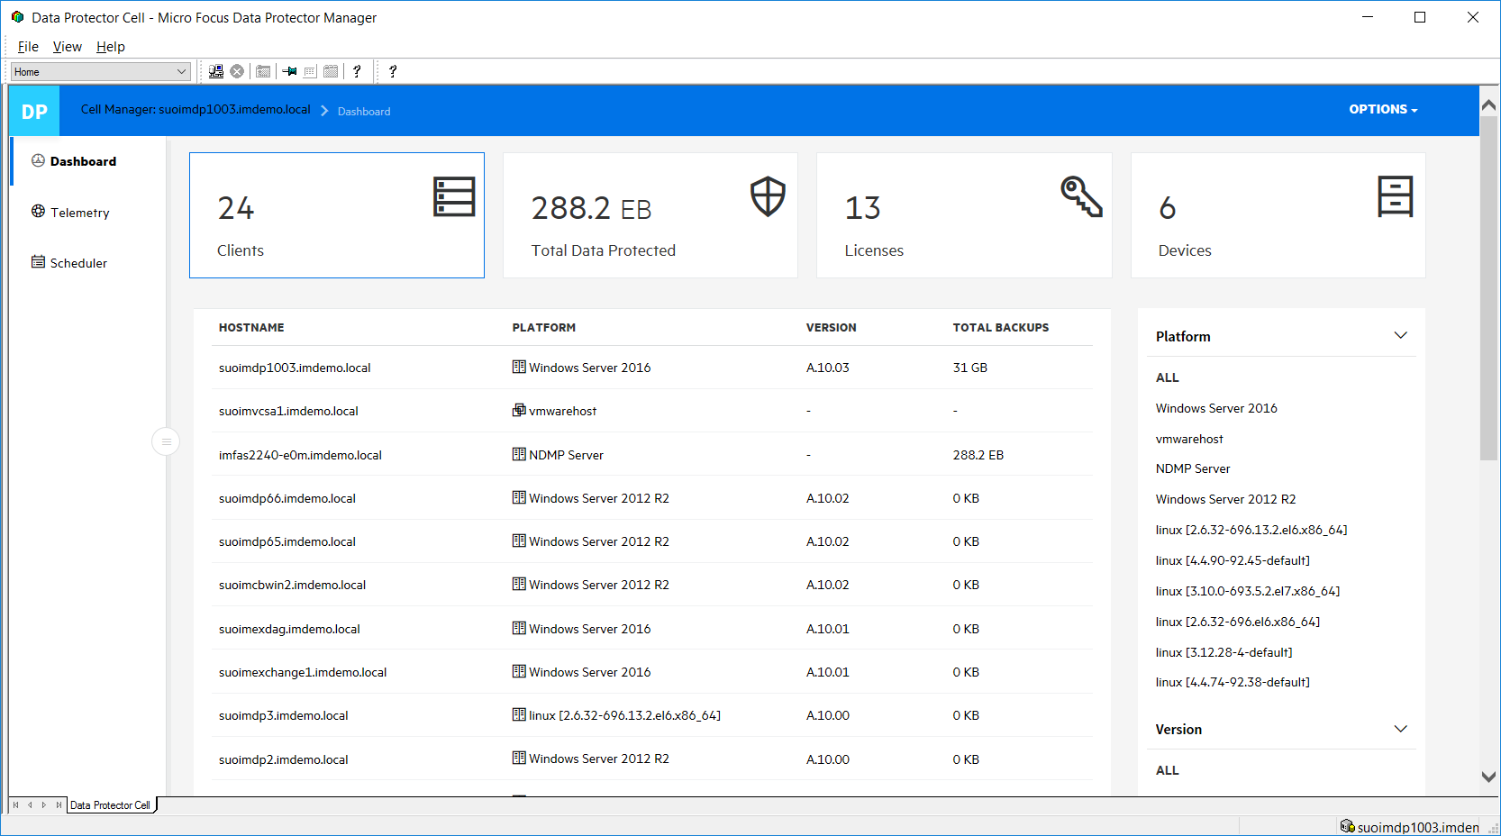
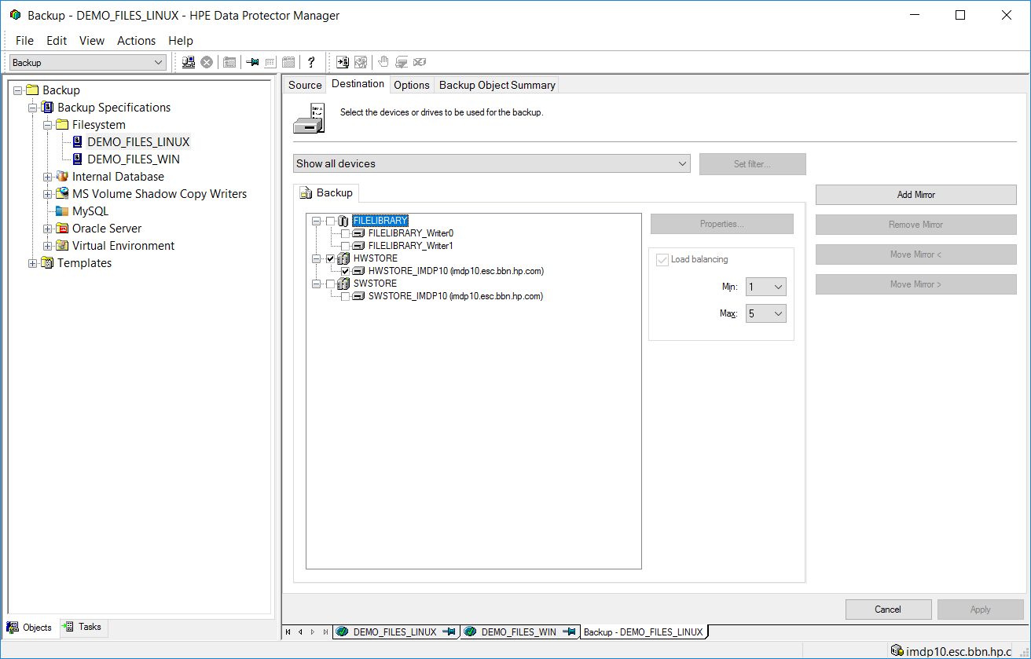
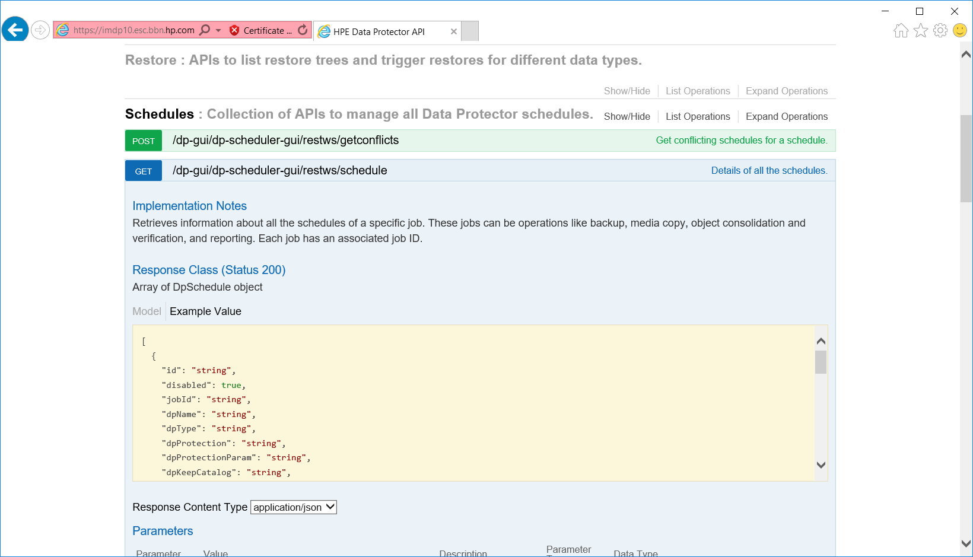
Data Protector APIs
Secure access through various management interfaces
Traditional GUI
Web Browser
REST API & CLI
Data Protector Cell Manager
7
Notes:
Three major ways to comunicate with a Cell Manager.
Web access allows for dashboard overview or enterprise grade schedule overview
The REST API can be used by service providers to create BaaS approaches
New with DP 2019.05 (aka DP 10.40): Dashboard is now using Chromium for better performance

Slide 8






Performance and Optimization
Get the most of your data protection infrastructure, meet backup windows
Snapshot-based backup and recovery
Multiplexed & Parallel data streams
Snapshot Backup (ZDB)
Instant Recovery (IR)
Clients
Snap
Others
Backup device
Deduplication everywhere
System independance
restore
import
Source
Media Server
StoreOnce DataDomain
Replication
Cloud Bank Cloud Tier
backup
offload
replication
Notes:
Animated
Top left: Snapshot backup and restore (ZDB/IR). Helps to offload the client system while backup
Top right: Using all possible paths in parallel offering great performance
Bottom right: Use any supported platform to move your data around. Any cross-combination.
Bottom left: Deduplicated at any place. Optimize where you want.

Slide 9
Best-In-Class for Remote and Branch Office
Small remote office
Corporate datacenter
No local backup devices
Micro Focus
Data Protector
Micro Focus Data Protector
Micro Focus Backup Navigator
Backup Appliance
Medium remote office / branch office
Local Dedupe
via Disk Store
or VSA
Disaster recovery site
Media Server
One integrated, centrally-managed solution:
Data Protector
DP Reporting Server
Backup Appliances
Storage Systems
Help manage and protect growing volumes of data (flexible deduplication)
Meet availability SLAs cost-effectively
Scale across thousands of sites
Backup Appliance
Tape and others
Notes:
Animated
Shows standard DataCenter and DR Site layout
Small ROBO: No local backup device wanted. Source side dedupe used.
Medium ROBO: Local Software Store or small SO/DD device for fast local backup/restore.

Slide 10
Application-consistent recovery

Slide 11

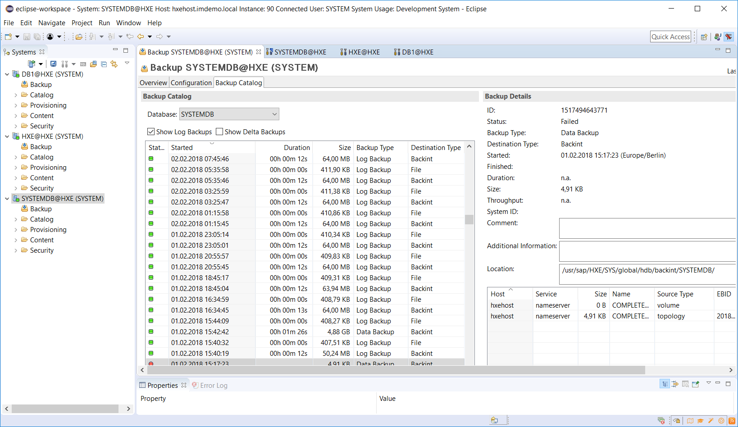
Application Integrations – SAP
Consistent data protection and compliance
SAP/R3 and NetWeaver SAP HANA
Supports BackINT API (BRtools etc.)
SAP/R3 with Disk Snapshot (ZDB) and Instant Recovery (IR)
System Copy/Database Copy
SAP/R3 with MaxDB/SAPDB/Oracle
SAP HANA with scripted snapshots
Multi-Stream Backup
Support Matrix
Notes:
Some bullet points on how DP integrates with SAP HANA and other variants.
Highlight SAP BRtools (BackInt) compatibility!

Slide 12

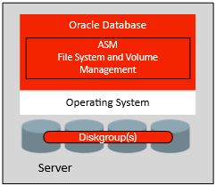
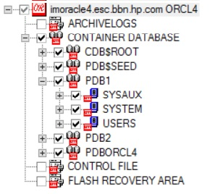
Application Integrations – Oracle
Consistent data protection and compliance
Oracle Database:
Real Application Cluster (RAC)
Container Databases (CDB)
Automatic Storage Management (ASM)
Restore to Point-in-Time, Transaction, Sequence
Restore to different Oracle System
Full Oracle RMAN compliance
Zero DownTime Backup (ZDB) and Instant Recovery (IR)
Support Matrix
Notes:
Oracle interation features. Highlight RMAN compatibility!
Also important: Oracle RAC, CDB, ASM since this is what seperates the boys from the men ;-)

Slide 13



Application Integrations – Microsoft
Consistent data protection and compliance
MS Exchange Server ▪ MS SQL Server ▪ MS Sharepoint Server
Database Availability Groups (AG/DAG)
Standalone and Clustered
Active/Passive Copy backup/restore
SharePoint Farm Backup/Restore
Granular Recovery for Exchange and SharePoint
VSS and VDI compliant
VSS Transportable Backup (ZDB)
SharePoint Farm Backup
Support Matrix
Notes:
Integrations with MS Apps and their features.

Slide 14
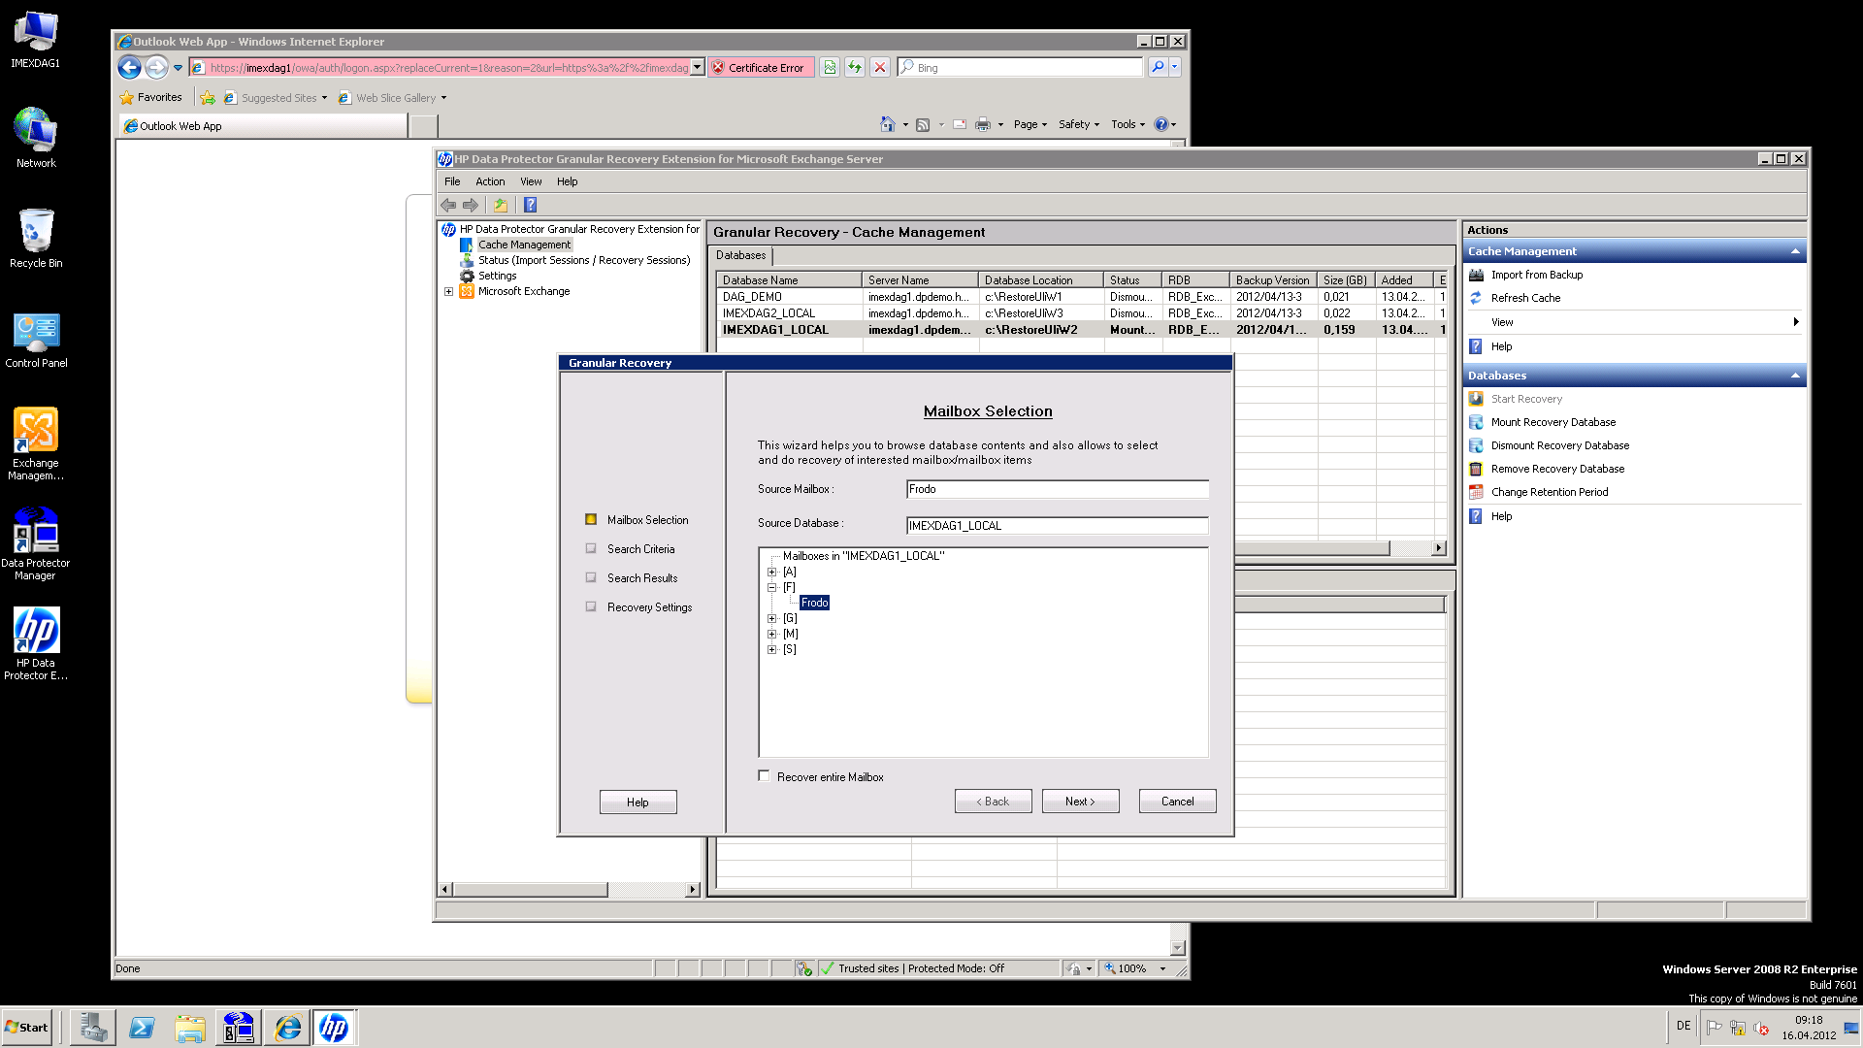
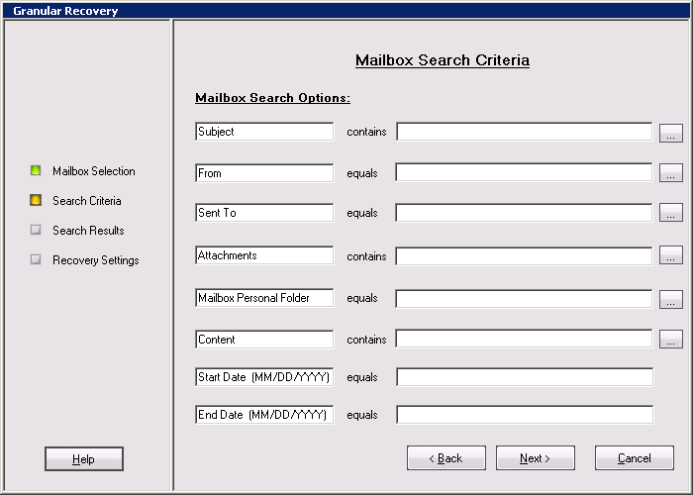
MS Exchange Granular Recovery Extension
Highlight the restored DB
in Cache Management
Start Recovery
Pick a Mailbox
Seach options
Support Matrix

Slide 15
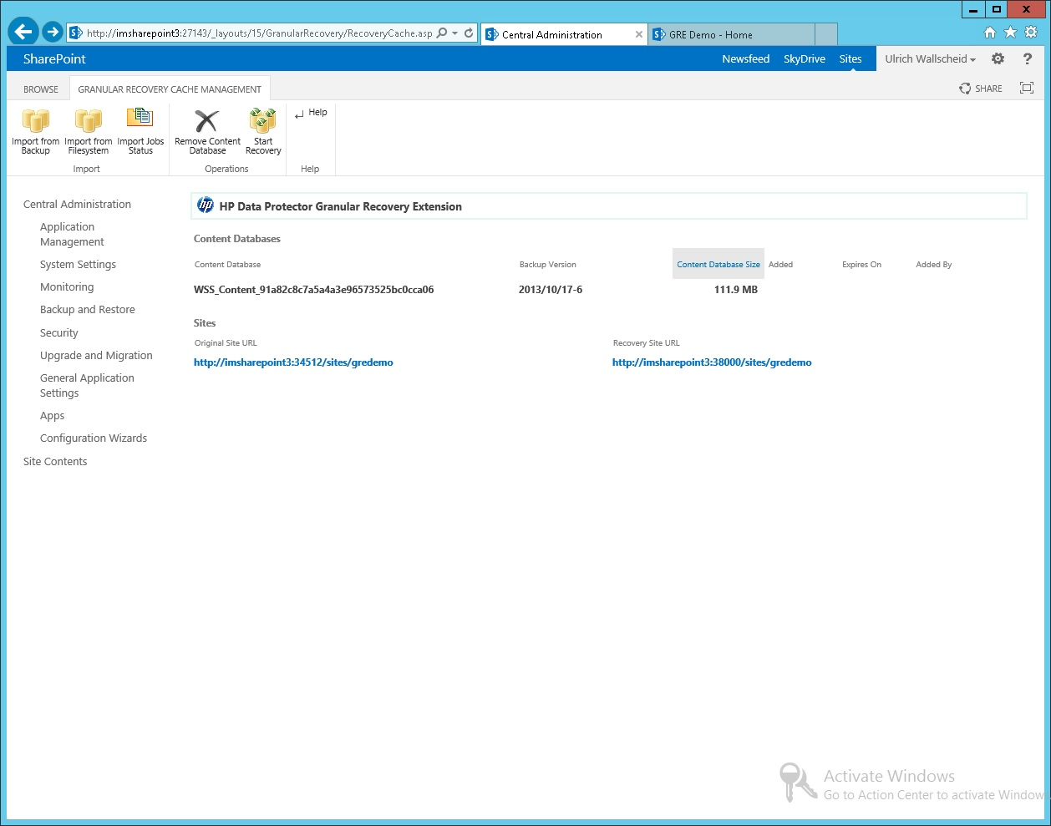
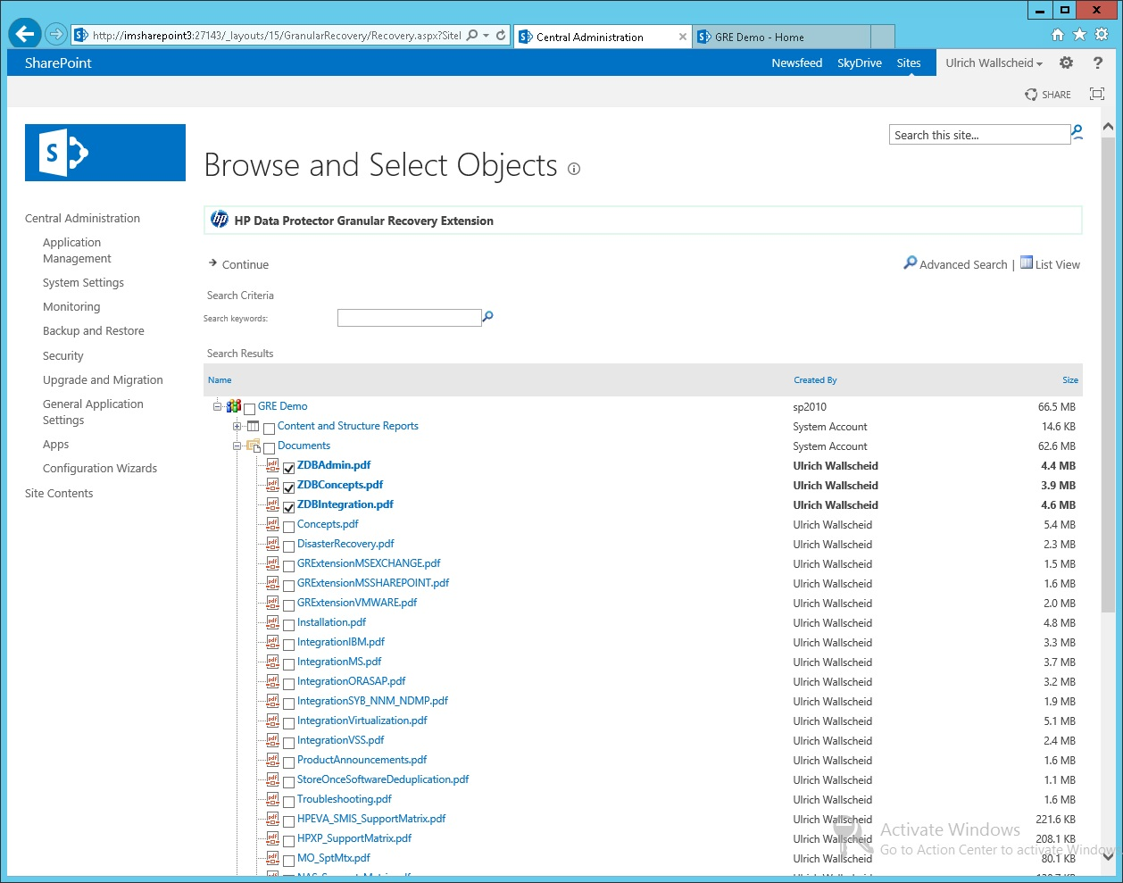
MS SharePoint Granular Recovery Extension
Select the Site for recovery from the sites lilst. Select recovery type.
Select documents or other objects to be restored from the site tree.
Documents
Calendar entries
Tasks, and more

Slide 16

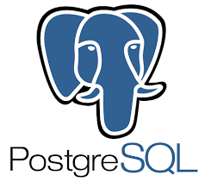
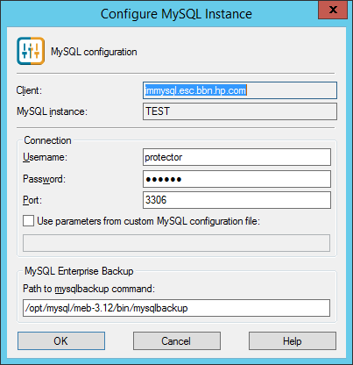
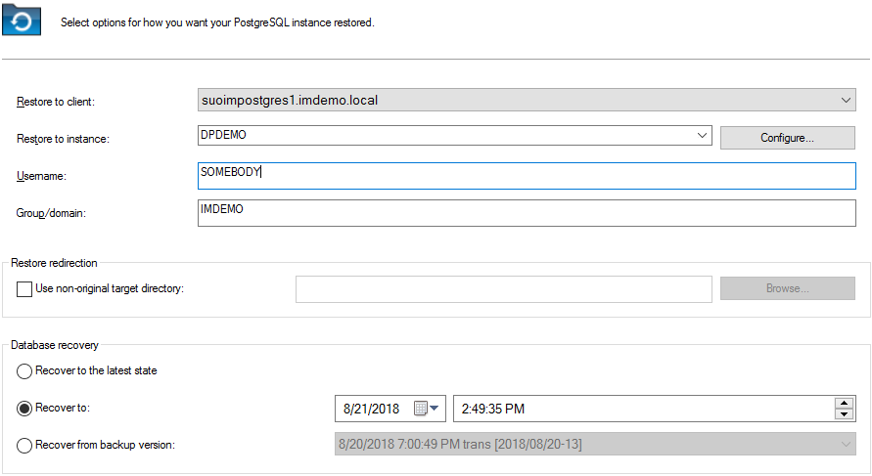


Integrations – IBM, PostgreSQL, Sybase, MySQL
Consistent data protection and compliance
Restore redirection
Restore to Point-in-Time
Separate data file vs. log file backup/restore
Multi-Master Cluster support for PostgreSQL
Support Matrix
Notes:
Many more DataBase servers/systems are supported as well. Each one is taken care of with a dedicated agent.

Slide 17
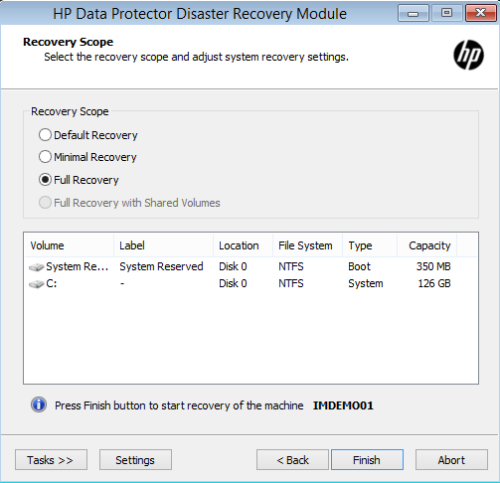
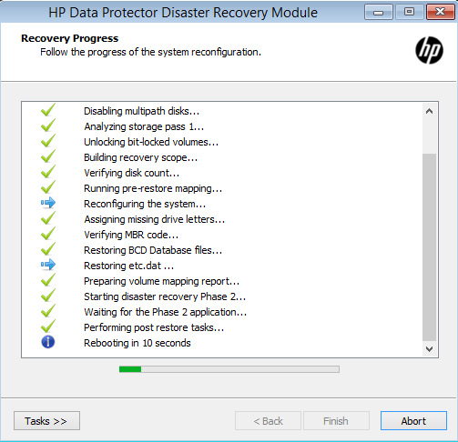
Cluster/HA Integrations & Disaster Recovery
High Availability:
Windows Failover Clusters and Cluster Shared Volumes
Linux Built-In Clusters and HPE MC/Service Guard
Veritas Cluster
Bare Metal Disaster Recovery:
Enhanced Automated Disaster Recovery (EADR)
Manual DR
DR to different system
DR to Virtual Machine (P2V)
Boot from tape/USB drive
Restore local/remote
Support Matrix
Notes:
DP supports backup/restore of clusters. DP itself can also be installed in a cluster to enhance HA.
We do BareMetal DR of course (for free!). Highlight the fact DP can do DR to dissimilar hardware.

Slide 18
Application Integrations Summary
Data Protector supports mission-critical applications by using dedicated agents to offer application level data consistency.
By using backup APIs for applications Data Protector is aware of the internal features such as clustering, replication, active-passive availability groups, and can react appropriately during backup and recovery.
This approach offers indepedance of how and where applications are deployed such as physical, virtual or cloud deployments.
Data Protector gathers analytical data in parallel to backup to track and manage SLAs, performance and capacity data as well as predictive information for future planning and optimization.

Slide 19
Advanced Virtual Environment Protection
Notes:
Focus is on Vmware and Hyper-V. Other Hypervisor VMs like from KVM or RHEV can be backed up using scripts.

Slide 20

Hypervisor Integrations – Microsoft
Microsoft Hyper-V:
Cluster Shared Volumes (CSV)
Direct FC/SAN Backup with Snapshots
VM Replica Backup
Full/Incremental VM Backup
VSS Transportable Backup (ZDB)
FC SCSI
FC IP Deduped
Snapshots
Support Matrix
Notes:
This is how DP integrates with MS Hyper-V. Highlight direct SAN and CSV backup support.

Slide 21
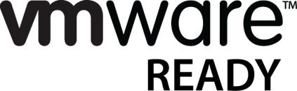
Hypervisor Integrations – VMware
VMware vSphere/vCenter:
FC SAN/LAN Snapshot Backup
VM Power On and Live Migration
Granular File Recovery
Change Block Tracking
True parallel vDisk backup
Restore VM with diff. Name
Redirected restores
Storage System Snapshots (ZDB)
LAN iSCSI FC SAN
Support Matrix
Notes:
VMware backup features. Somewhat more feature-rich than Hyper-V, but that mostly comes from the better vStorage VADP API VMware has. Hightlight ZDB, Power-On and Live-Migration. A animated demo of that is coming up in three slides from here.

Slide 22
VMware Enhanced Options
Application aware backup
Agentless and Application consistent backup of VM's running
MS Exchange
MS SQL
MS Sharepoint
Oracle DB (Windows)

Slide 23
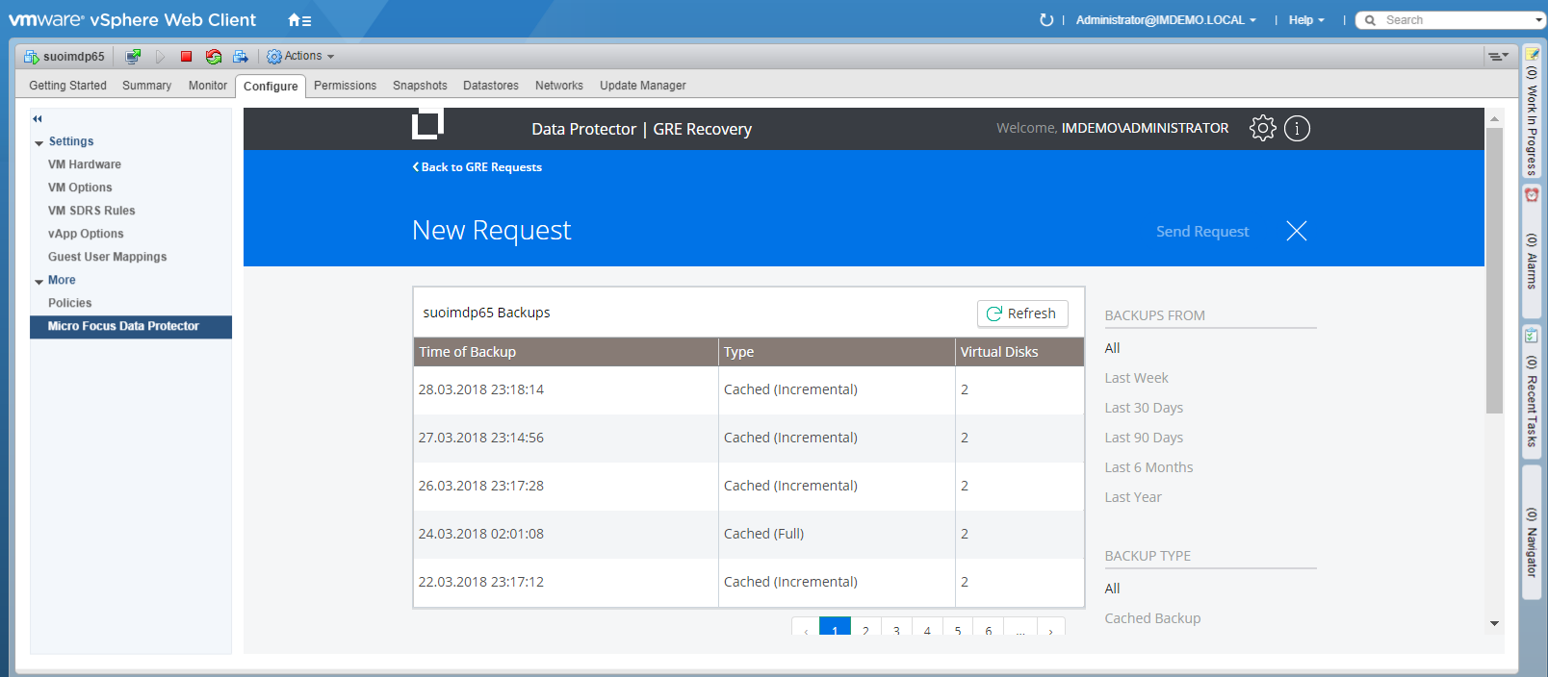
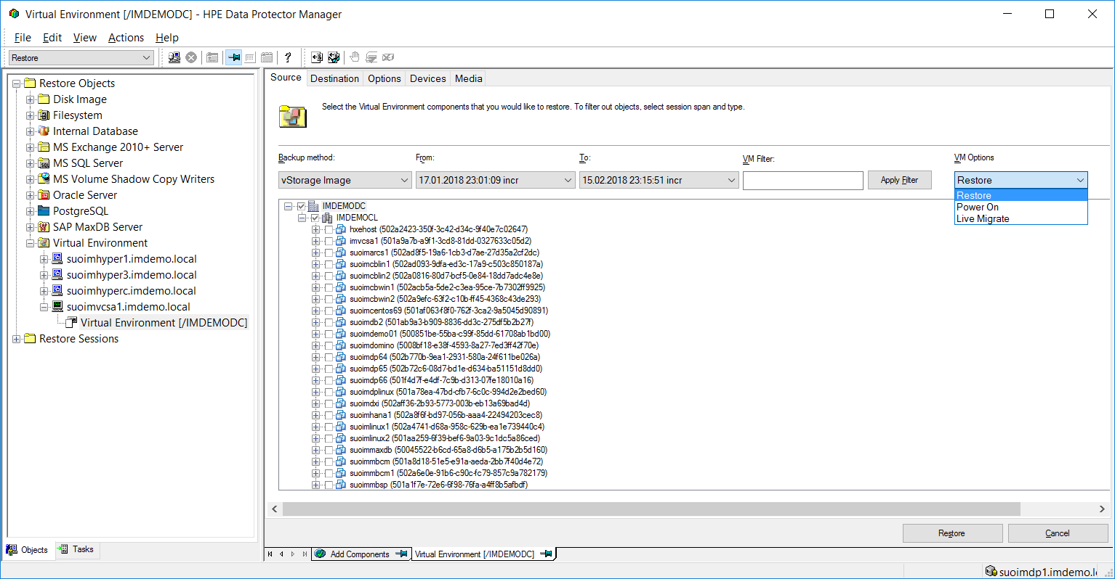
VMware Enhanced Options
Granular Recovery, Power-On, Live-Migration
Notes:
VMware GRE screenshot. This is the plugin into vCenter Web Client.
DP GUI offering restore, Power-On and Live Migration

Slide 24
VMware Enhanced Options
Using the Power of Backup Appliances
Equal feature set for major VTL Appliances and Virtual Editions
 | HPE StoreOnce Catalst | EMC DataDomain DDBoost
VMware GRE | ü | ü
VMware Power-On | ü | ü
VMware Live Migration | ü | ü
Virtual/Synthetic Full | ü | ü

Slide 25
VM Hypervisors – Hardware Assisted Backup
Data Protector
Cell Manager
VEPA
Backup Host
(Media Server)
Snapshot mount Backup flow
SMI-S/VSS
Disk System
Notes:
VEPA = Virtual Environment Protection Agent (VMware / Hyper-V)
SMI-S = Storage Management Initiative - Specification (www.snia.org)
VSS = MS Virtual Shadow Copy Framework

Slide 26
Power-On & Live-Migration of VMware VMs
From HPE 3PAR snapshot, HPE StoreOnce Appliance or SmartCache
Micro Focus Data Protector
VM presented
by NFS mount
Backup Host
Option A: Data Protector Smart Cache
Restore
Option B: HPE 3PAR snapshot
Option C: HPE StoreOnce or EMC DataDomain
Backup
Appliance
Smart Cache
Disk System
Notes:
PowerOn Steps:
Backup image is prepared for restore (from 3PAR Snap, SmartCache or StoreOnce)
VM is registered and presented to ESX farm via NFS
LiveMigration Steps:
Backup image is prepared for restore (from 3PAR Snap, SmartCache or StoreOnce)
VM is registered and presented to ESX farm via NFS
VM is restored in the background from backup device into datastore of your choice

Slide 27

KVM Hypervisor Protection
KVM doesn‘t come with a backup API comparable to VMware or Hyper-V. Because of that a scripted solution is used instead.
KVM (Kernel-based Virtual Machines) is an add-on that comes with RedHat Enterprise Linux or SUSE SLES (and others). Installation and usage is pretty much the same for both operating systems. Since some dependencies with KVM/QEMU exist it is recommended to use the very lastest versions of an operating system.
Notes:
KVM data protection is done with scripts.

Slide 28
Virtualization Integrations Summary
Data Protector fully integrates with VMware vSphere and MS Hyper-V virtualization platforms supporting various approaches such as local and remotesnapshot backup/recovery, Power-On and Life-Migration of VMs as well asgranular recovery of VM files using the same data protection infrastructure for all clients types (physical, virtual, cloud).
Data Protector reporting complements this functionality with virtualization reports, analytics and predictive analytics.
Other Hypervisors like KVM can be addressed with scripts. This would benefit by the automation/orchestration approach of Data Protector.

Slide 29
Best-in Class Platform Integrations: The Cloud

Slide 30
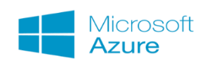




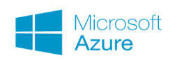
Cloud Integrations for Backup and Archive
Native Integration
Any server with a DP Media acts as a cloud gateway
Cloud Gateways
File
Library
Microsoft StorSimple Gateway
VTL
Amazon AWS Gateway
Backup Appliances
HPE StoreOnce
Catalyst
HPE StoreOnce Cloud Bank
DataDomain
Boost
Dell EMC Data Domain Cloud Tier
Notes:
Native is where the client backs up data directly to the cloud. No device in between.
Gateway is where a Cloud gateway is the backup target from a DP point of view. The gateway will then optimize and upload/download into the Cloud. Those gateways are usually offered by the Cloud vendors.
Appliances are makig use of their VTL features. SO and DD offer that as part of StroreOnce or Data Domain Firmware. The backup targetan the Cloud connection becomes one device.

Slide 31
HPE StoreOnce Cloud Bank operation
Data Protector
HPE StoreOnce Appliance
Object Copy
Replication
Backup
Cloud
Object Storage
Catalyst Store
Local Disk
Cloud Bank
Data Protector backs up data to the HPE StoreOnce appliance using Catalyst and block data is store on local disk
Next Object Copy job is executed to replicate from the primary store into the cloud gateway store
This triggers the appliance to upload to the cloud vendor so no local disk storage is used
Only delta-blocks are moved into or read from the cloud to optimize cost
Notes:
A Catalyst Store will put data blocks on local disk
A Cloud Bank Store will upload data blocks into the cloud, almost no local capacity is used.
The complete process is: Backup to local Catalyst Store, followed by DP Object Copy to Cloud Bank Store

Slide 32
Dell EMC Data Domain Cloud Tier operation
Data Protector
Dell EMC Data Domain
Cloud Tier
Policy
Backup
Data Protector backs up data to the Dell EMC Data Domain appliance using DD Boost
The appliance manages the upload and download into or from the Cloud in deduplicated format
This process is done by internal policies not controlled and therefore transparent to Data Protector
Notes:
EMC Cloud Tier works different to SO Cloud Bank since data is uploaded to the cloud by policies set inside
the DD appliance. The backup software is not actively involved.

Slide 33
Backup to HPE StoreOnce VSA Cloud Instance
Different Workloads
in local IT
HPE/EMC VSA
Data Protector can make use of Cloud VSA's
In this case data is deduplicated on the source-side
Cloud VSA's are compatible with their physical appliance partners (see vendor documentation)
Notes:
VSA = Virtual Storage Appliance (usually available in Hypervisors, local and cloud)
Alternative to a local type library. StoreOnce VSA or DataDomain sits in the Cloud getting deduped data
from the clients.

Slide 34
Orchestrating Backup within the Cloud
Data Center
Cloud VMs or
Container
Agent Control
Backup flow
HPE Catalyst or EMC DD Boost Replication
Let's assume you have a virtual Backup Appliance in your Cloud:
Data Protector can remote control agents in the VMs or Containers and direct backup and restore I/O to that Cloud backup appliance
Optionally deduplicated replication to a compatible partner device in the DataCenter can be set up
Notes:
Lets say we have Cloud VM/Containers with standard opertating system and DP agents installed. The DP Cell Manager can remote control those agents to stream data to any device of your choice. Can be a cloud backup device like StoreOnce or DataDomain. From here you can replicate some or all data to a device outside the cloud.

Slide 35
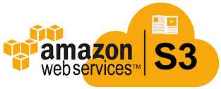
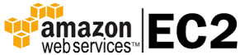
Data Protector Solution for AWS
DP Cell
Manager
DP Media
Server VM
(Linux)
Create Snapshots
Replicate to S3
Notes:
This is a scripted solution approach where VM Workloads in AWS EC2 are snapshotted first
then replicated into AWS S3 storage. Advantage is that backup data is separate from live data
and you can make use of DP scheduling, reporting and monitoring for your Hybrid-IT approach.

Slide 36
Cloud Integrations Summary
Data Protector allows to offload or archive data into various cloud vendor offerings.
Data Protector organizes cloud access the same way as with generic backup devices allowing for easy integration into an existing protection strategy.
Cloud backup devices can be used from many client systems to streamline data flow and to offer load-balancing or redirection.
By supporting advanced options such as HPE Store Once Cloud Bank and EMC Cloud Tier, enterprises can organize cloud offload and archive without making any strategy changes.

Slide 37
Best-in Class Platform Integrations: Storage
Notes:
This is mainly about Disk System Snapshots and Backup devices

Slide 38
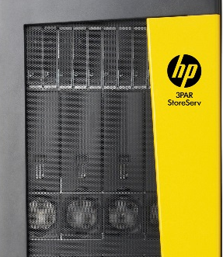
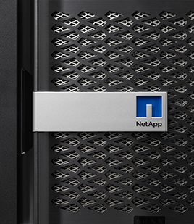
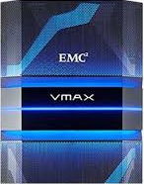
Data Protector Disk Storage Integrations
Snapshot backup and restore, replication
HPE
NetApp
EMC
Notes:
Some examples of Disk Storage Systems DP support. See support matrix for more details.
Storage Snapshots (ZDB) are mainly used to offload backup I/O from client systems. This approach also improves backup performance since you have a dedicated and tuned backup server to deal with data movement.

Slide 39
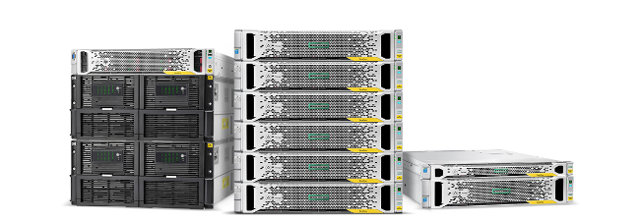
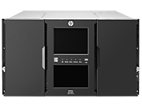
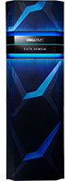
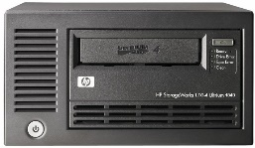
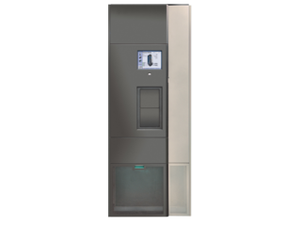
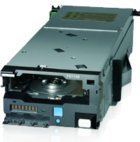
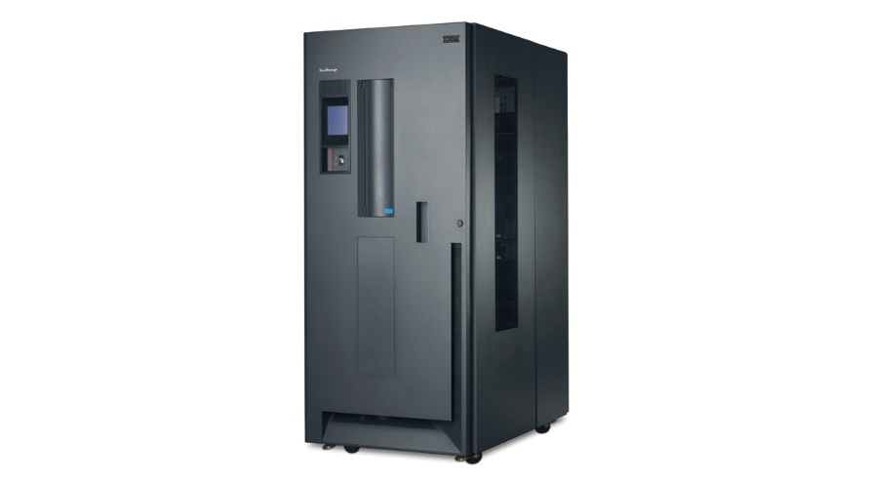
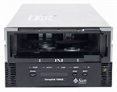
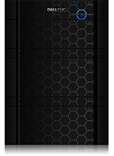
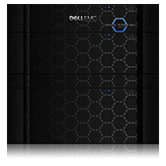
Data Protector Backup Device Integrations
VTL/Appliances
Tape Libraries
Tape Drives
HPE Store Once
Dell EMC Data Domain
HPE StoreEver, Quantum/Adic, IBM, StorageTek, Overland
LTO, AIT, Exabyte, STK, IBM, DAT, DTF, Tandberg
Please check the DP Support Matrix for a full list of supported devices
Notes:
Why we're still supporting Tape? It's the cheapest medium around ($/GB), it offers true long term retention and it can be exported and send aroud world or stored in a secure place. Ransomware cannot reach it ... and lets not forget that Tape still outperforms some disk based backup solutions (individual stream performance).
Some examples of Tape/VTL Systems DP support. See support matrix for more details.
StoreOnce and Data Domain VTLs offer deduplication and replication. Both can be set up and managed using the DP GUI. All activity will be stored in DP for consolidated reporting and handling.

Slide 40
Disk and Flash Storage Integrations example
HPE 3PAR example
Any
Backup
Device
Cloud
Storage
DR Site
System
Syncronous Remote Copy
Backup
Server
Production
System
Snapshots
Notes:
Animated
Example of using DP ZDB with 3PAR Remote Synchronous Copy to offload the production 3PAR shown on the right of the screen. Why? Because backup I/O is completely removed from the production system and all backup activity happens in the remote DR site.

Slide 41
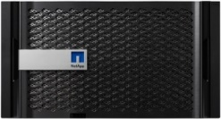
DP Zero DownTime Backup & SnapMirror
Source NetApp Filer
Destination NetApp Filer
2. Sync SnapMirror relation
1. Create a Flexvolume snapshot at source
3. Create a FlexVolume Clone at destination using source snapshot
5. Mount replica to backup server
4. Create a read/write replica using this Clone
6. Backup to any device
Notes:
ZDB can make use of NetApp SnapMirror.
Can be done within the same System or between two separate System.
Same configuration as other ZDB.

Slide 42
Backup Device Management Options
Deduplication and more
Flexible Protection Paths
Media Server
Source
Source
Remote
Native Cloud
Direct (local)
Other Sources
Backup Target
Backup Target
HPE StoreOnce Dell EMC Data Domain
Replication
HPE Store Once Cloud Bank Cloud Tier
Consolidation & Optimization
LTO-4
LTO-6
Migration
Tape
Tape
Media A
Media B
Notes:
Animated
Top left: Various ways to store data to backup devices using local and remote deduplication.
Top right: Backup to locally attached device vs. remote device via Media Server. Many to one.
Bottom right: Consolidation of outdated media to current media. Migration between vendors.

Slide 43
Optimize with Federated Deduplication
Application source
Backup server
Target system
Software only implementation can use generic disk
Purpose built appliance optimized for backup data
Simplest implementation – no operational changes
Application source
Backup server
Target system
Offload application source from dedupe processing
Higher total target system throughput
Efficient utilization of backup infrastructure
Low-bandwidth
Application source
(Backup server)
Target system
Dedupe where data is created – application source
Eliminate need for extra hardware at ROBO sites
Reduces network bandwidth consumption
Backup Server is optional for source side dedupe
Low-bandwidth
Low-bandwidth
Notes:
Federated deduplication means a few things:
It’s the same deduplication engine across our portfolio - data written to one StoreOnce appliance (physical or virtual) can replicate data to another StoreOnce appliance without rehydrating the data.
It also means that we can enhance the capabilities of deduplication by extending the participation in the process from the StoreOnce appliance to the backup server and even to the application source, using Catalyst, our HPE developed API, which allows us to interact more intelligently with backup applications as well as extend the capabilities of deduplication throughout the backup process.
Here are three examples of how we can extend deduplication throughout the process, greatly reducing the amount of data being transmitted from source to target:
In the first example, we enable the application source to take part in the deduplication process. This allows only unique blocks of data to be sent from the host to the target.
Where resources may be limited, the backup server can participate in the deduplication process, so traffic between the backup server and the StoreOnce target is optimized.
In either case, there is little overhead required to have the application source or the backup server take part: they are essentially calculating a hash value on a given set of data and inquiring with the target appliance as to whether that data already resides there. If so, the data is not sent across the wire; a reference is simply created to maintain the structure of the data for recovery purposes. Datasets whose patterns do not yet reside on the appliance are sent. In this fashion, it is possible to greatly reduce the amount of data traversing the network while requiring minimal resources on the application source or backup server. The closer to the application source that this is performed, the greater the reduction in network bandwidth requirements.
In the final example, the StoreOnce appliance itself performs all of the deduplication as the data is received, upon ingest. As a purpose built appliance, we design StoreOnce appliances with this functionality in mind. Distributing the deduplication process to the backup server and application source simply allows us to reduce the network bandwidth requirements and reduce the amount of time required to complete the backup job—it’s a way for customers to enable greater functionality and efficiency.

Slide 44
Automated Backup Data Replication and Synchronization
Automated setup and workflow, no scripts
Local Site (Cell A)
Remote Site (Cell B)
Local Backup System
Remote Backup System
Restore to local client
Restore to remote client
Tape/Cloud etc ...
Automatic
Import
Initial Backup
HPE Store Once or EMC Data Domain Replication (optimized data)
Local Device
Remote Device
Notes:
Animated
Backup to a local dedupe VTL (StoreOnce or Data Domain
replication to remote site
Import of backup data at remote site into seperate Cell Manager
Possibility to offload to "archive" or to restore to various places.

Slide 45
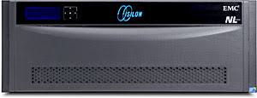
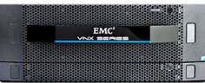

NDMP 2-Way and 3-Way Backup
Enables backups to be done via a standard media/backup server connected by LAN
3-Way NDMP Example
StoreOnce &
DataDomain
or
File Library
DP
NDMP
MA
Enables backups via NDMP for filers without a local backup device.
Also for concentrating backup via a common Media server with deduplication enabled. File Library support for customers without a Backup Appliance.
Netapp
EMC Isilon
EMC VNX
EMC UNITY
Notes:
Animated
DP is doing NDMP backups for quite a while. First approach was to backup to locally attached backup devices connected by SCSI or FC SAN with the 2-Way NDMP approach.
Many infrastructure combinations are now supported using the 3-Way approach where the Media Agent (MA)
plays the role of an active NDMP manager to stream data to etwork connected devices. See support matrix.

Slide 46
Storage Integrations Summary
Disk storage snapshots help to offload clients systems from backup I/O and to speed up backup and recovery processes and their SLAs.
ZDB allows to rotate a number of snapshots and manage them from the Data Protector GUI.
Instant recovery allows to use snapshots like virtual media to replay to the original virtual disk. The process also restores application logs to recover to any point-in-time needed. These solutions are aimed at very high SLA requirememts.
Smart integrations into backup targets allow to organize and optimize data lifecycle. Built-in features such as Object Copy makes it easy to move data around and adapt media type and retention time for instance.

Slide 47
Integrated Disaster Recovery
Notes:
This is mainly about Disk System Snapshots and Backup devices

Slide 48
Integrated Disaster Recovery
Built-in, no additional cost recovery with a single click
A wizard-driven bare metal recovery process:
Single click recovery
No additional cost
ISO image created on tape, disk or USB drive
Flexible recovery from or to any physical or virtual system from any backup
Same system
recovery
Different system
recovery
Physical to VM
recovery
Notes:
Wizard-driven Enhanced Automated Disaster Recovery provides backup of application data as well as system data including operating system files, drivers, and files required for the initial boot process. Enabled with a simple check box in the Data Protection GUI, EADR includes the necessary image information in full backups for a full system recovery. Disaster recovery images can be created from any existing file system or image backup including object copies, without needing to create a separate special backup for system recovery.
Automated DR: Centralized bare-metal recovery from physical to physical, physical to virtual, virtual to virtual, and virtual to physical from any backup set at no additional cost.

Slide 49
Analysis, Automation and Orchestration

Slide 50
Analyzing and Optimizing Backup and Recovery Strategy
Once backup jobs are created and scheduled, you need to know if they were executed in an optimal way. If jobs fail to execute, they create missing links in the restore chain. Restores can‘t be done to that point and restoring the full backup object might become slower than expected. Both RPO and RTO are affected.
There may also be performance or capacity issues that need to be addressed. But how big is the issue and how much effort needs to go into a solution approach.

Slide 51
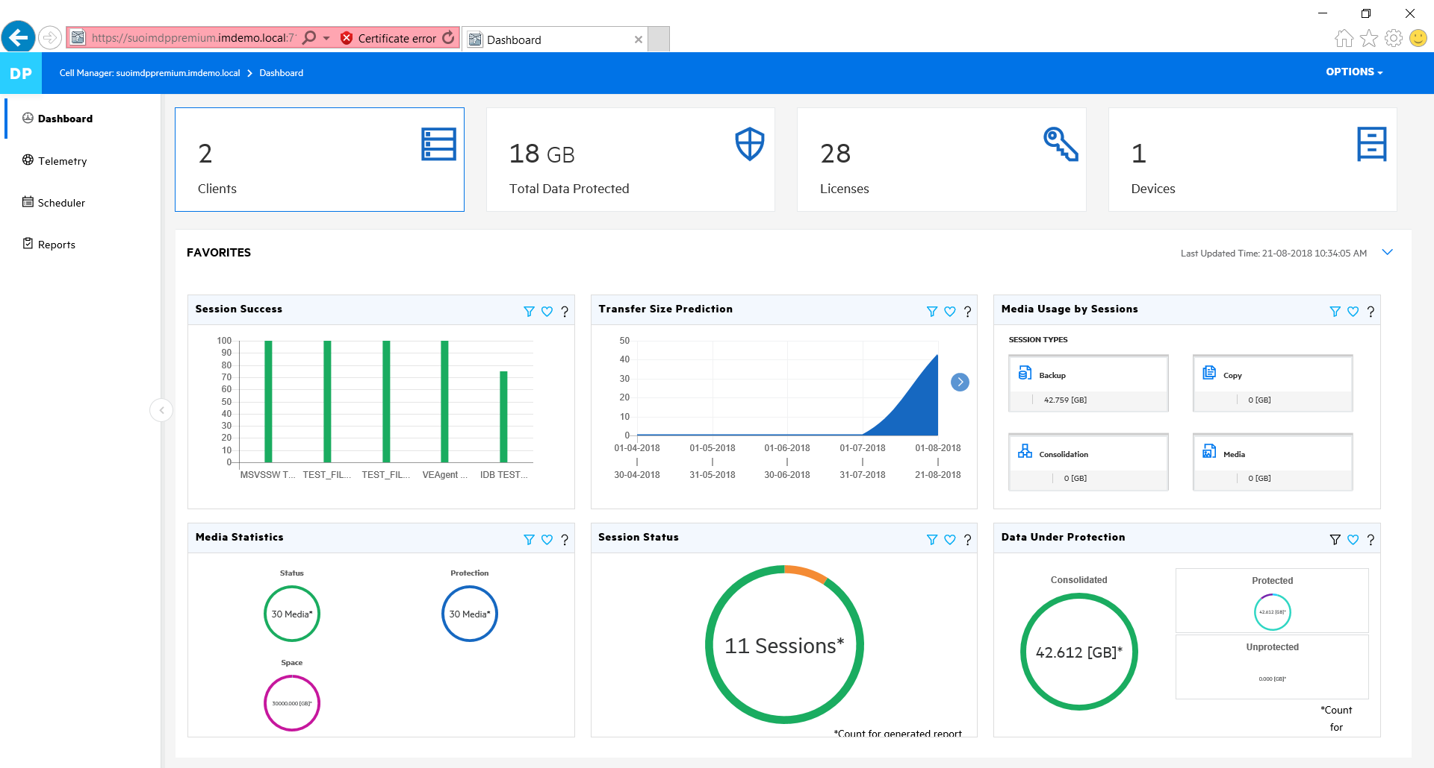
At-a-Glance View into SLAs, Sessions, Size …
See all critical backup metrics on a single summary dashboard or on out-of-box reports
Built-in analytics shows prediction of transfer size
Clear indentification of which storage media was used by session.
Percentage of successful backups is critical for mgmt. reviews
Easy tracking of RPOs and RTOs for mission critical applications
Backup session status
General stats on how much data is being protected
Notes:
This is the Dashboard view of Backup Navigator. It highlights important information in one overview, like current success rate, RPO/RTO info, service availability …

Slide 52
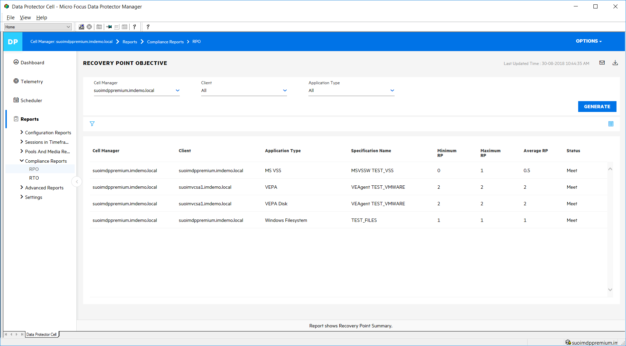
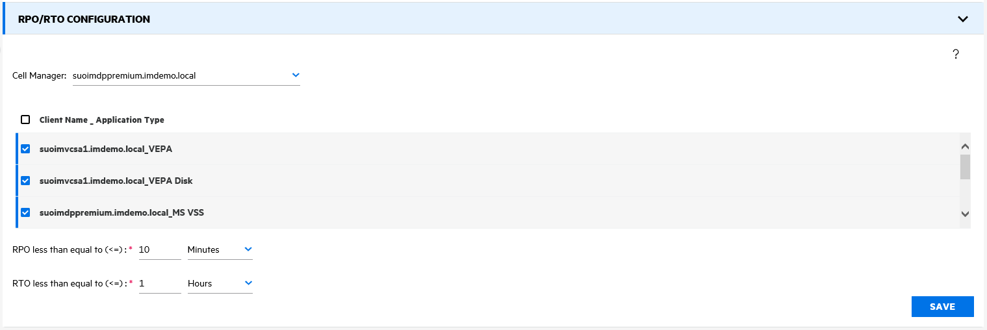
Application Overview for SLAs, RPO & RTO
Effective SLAs
SLA settings
Notes:
This application overview is perfect to show what the individual RPO/RTO ooks like per backups done. Customers can assign categories to reflect their own needs and to catch systems which are out of spec very fast.

Slide 53
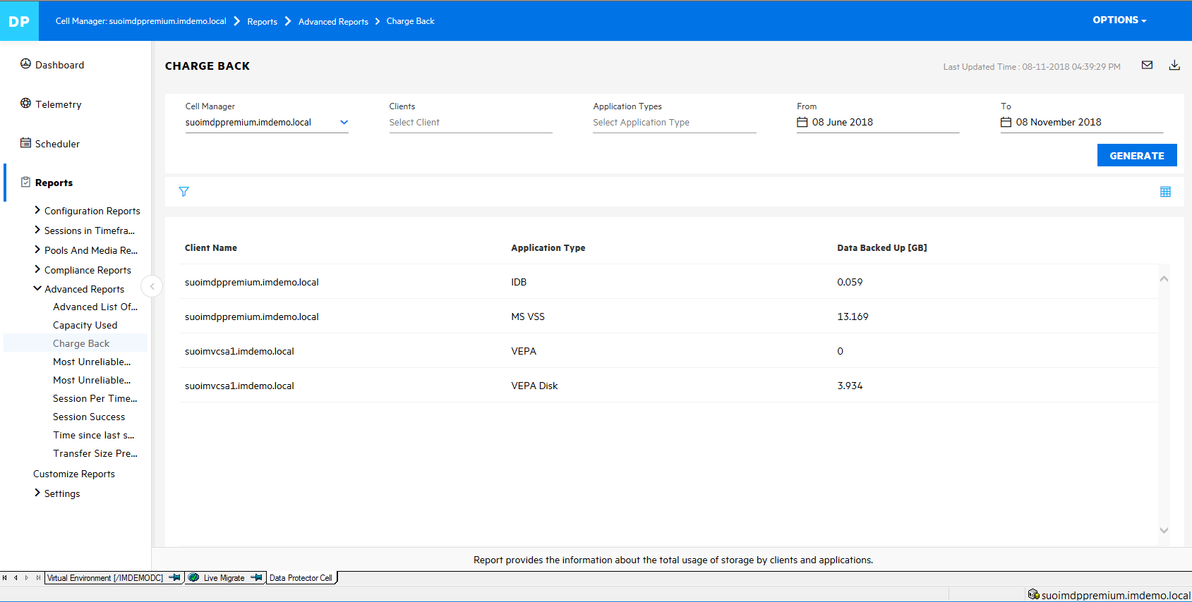
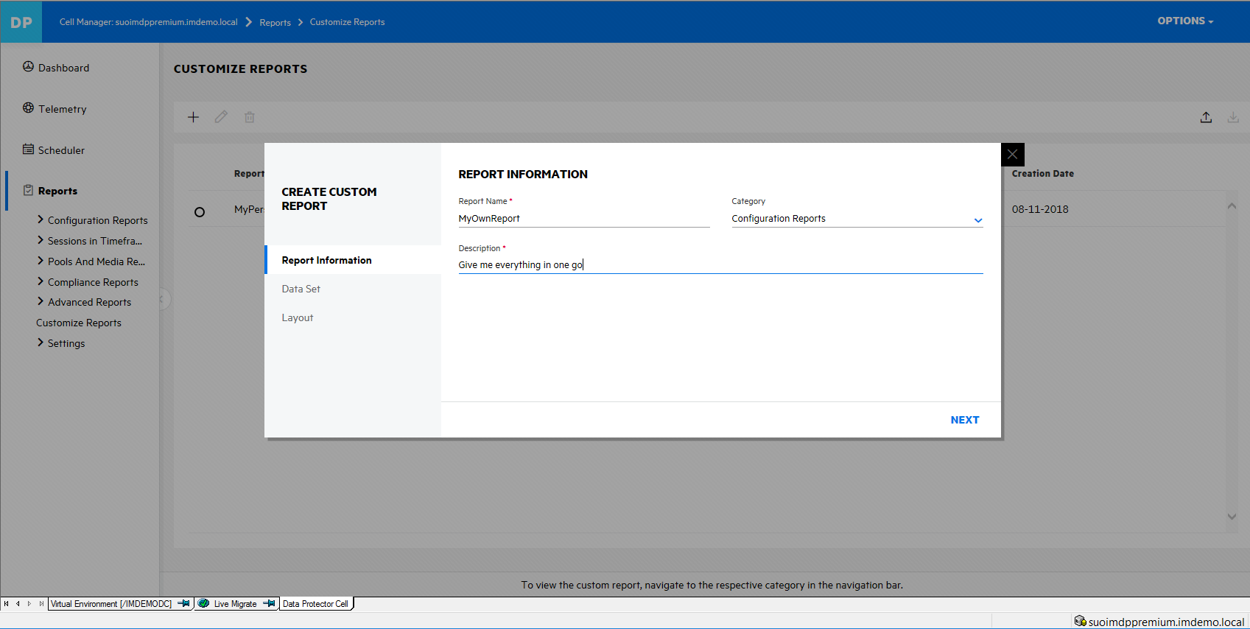
Chargeback and Custom Reports

Slide 54
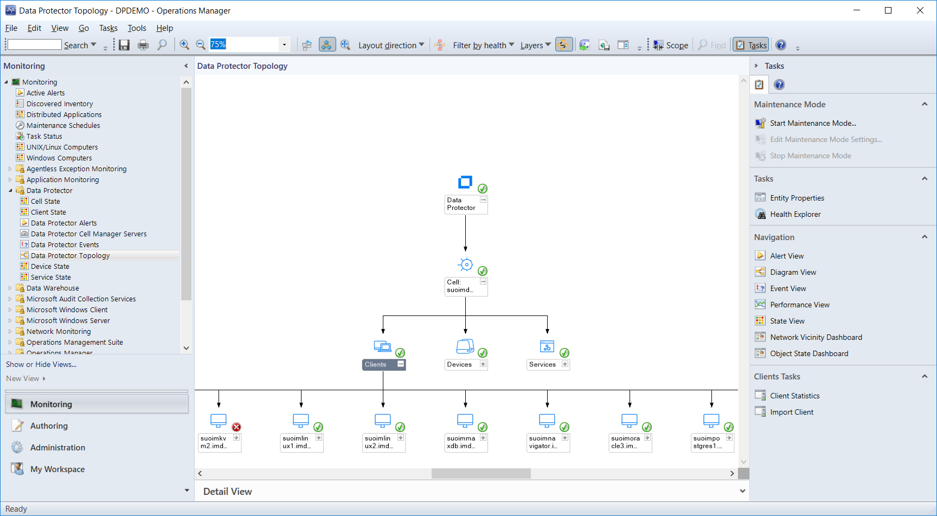
DP Management Plug In: Microsoft SCOM
Active alerting and event management for backup & recovery operations
Insight into health and status
Visualization of Data Protector environment and topology
Events, alarms and actions provided to address DP operations
Provides “recommendations” on how to remediate issues
Empowers operations staff to take action
Priced per Cell Manager monitored or bundled in DP Editions
Notes:
Plug-In for MS SCOM Server is available as separate license or included in DP Suite offerings.

Slide 55
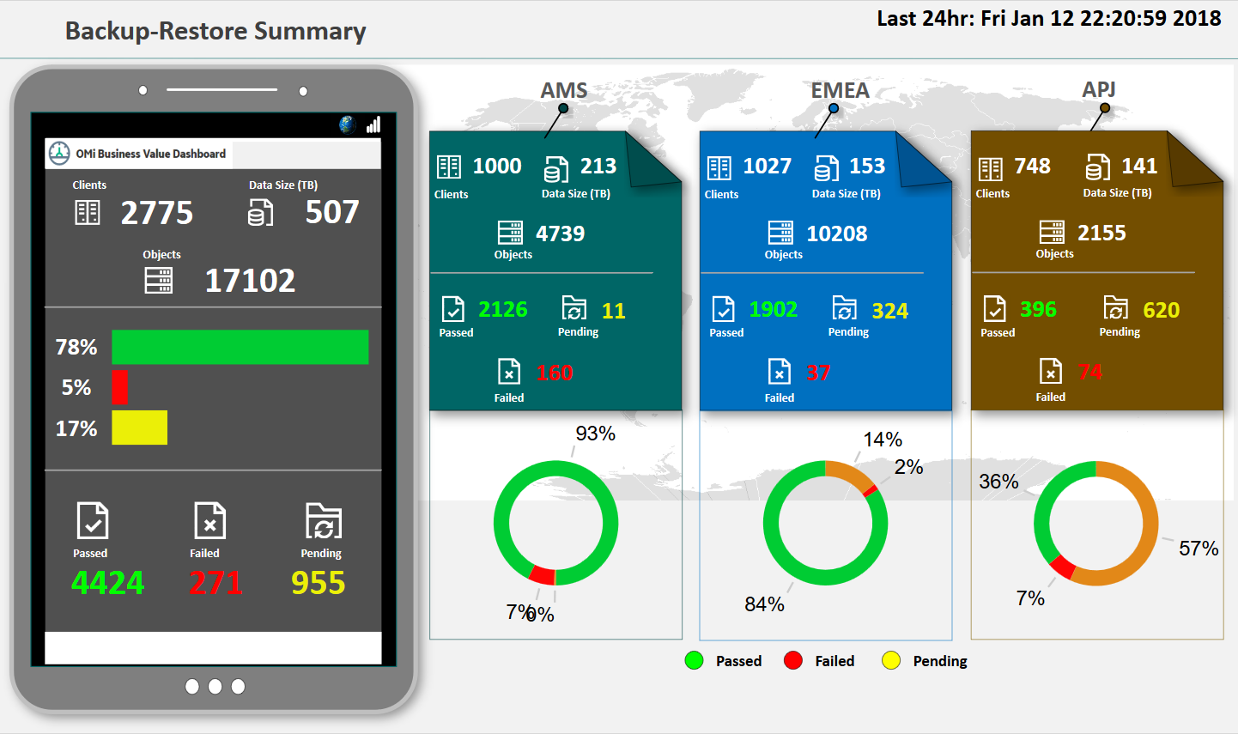
Business Value Dashboard (BVD)
Customized dashboard
Status at a glance
Drill down details
Notes:
Visualizing data and using it in right context is invaluable.
Today we present to you how we internally monitor one of our distributed Data Protector environment with Business Value Dashboard.
There are multiple Cell Managers geographically distributed with thousands of objects. This dashboard shows exactly what you want to know at a glance.
What you see here is just one representation of how your environmental data can be visualized. The dashboards is customizable.
This Dashboard also offers drill down section

Slide 56
Analytics Summary
Just scheduling a backup job might not be good enough. You may need feeback from the system if all planned activity got executed and it it meats the SLA goals.
Data Protector reporting gives you automated and flexible reports and lets you use them to drill into details, performance data, capacity comsumption and future prediction.
An easy-to-use Business Value Dashboard keeps you updated while on the move or just for executive information.

Slide 57
Security

Slide 58
Enterprise Class Scalability and Security
Built-in security against growing threats
Secure communication between members
Send me a list of all your files
Delete everything
Data Protector Security Model
Centralized command and control
Secure communication over TLS 1.2
Configurable blocking of TLS 1.0/1.1
AES-256 bit encryption
User authentication and LDAP integration
Network Port Consolidation - from hundreds to three
OK
No
Cell Manager
Agent
Rogue client
Centrallized command execution
May I execute this procedure?
OK
Cell Manager
Agent
Notes:
Built-in security model helps lower the risk of data loss with enterprise grade security
Data Protector has a centralized approach which is based on two premises:
Secure communication between the members
Close all comms gaps and security gaps between all members
Use latest security protocols to lock down communication bet members in the backup cell; can‘t sneek in and steel data
When scripts created, it can harm the system; lead to a security leek
Centralized command exection
Any command execution is validated and approved by Cell Manager
Protect against viruses, ransomware; attacs from the outside
A new ‘secure communication model enables a highly secure, reliable environment with low overhead. Features include:
Secure Peering: The Cell Manager can’t communicate to the Installation Server and vice versa until specific commands are entered and the fingerprints of each are verified, which configures ‘secure peering’.
Centralized Command Execution: No command, script or instructions are allowed to be sent to the INET process running on any of the DP clients other than the Cell Manager.
Network Port Consolidation: DP 9.09 consolidated the number of ports from thousands to 3. DP 10.00 moved from port ‘5555’ to DP’s own, IANA (Internet Assigned Numbers Authority) registered port of ‘5565’.
Push Installation Hardening (Linux/Unix/Windows): For Linux, DP uses ssh as the default mechanism to send and install software on new clients. For Windows server and client request SMB signing.

Slide 59
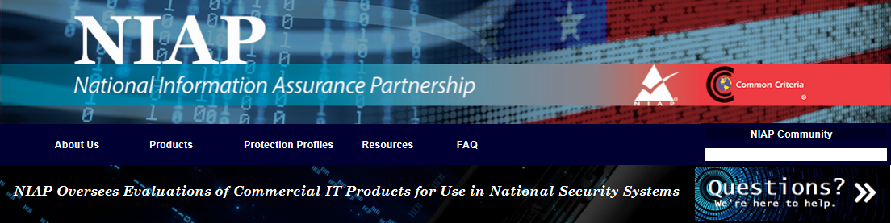
Security updates
White Hat Penetration testing and National Information Assurance
Partnership (NIAP) pre-check testing have been conducted to protect
against security vulnerabilities. https://www.niap-ccevs.org/
Notes:
The above items qualify for Common Criteria certification in preparation

Slide 60
Automation

Slide 61
Micro Focus Operations Orchestration
Enterprise-scale IT process automation
OO Studio - Design
OO Central - Run
Designer
Security
Administration
Dashboard and reporting
Debugger
Scheduler
Flow execution
API
Document generator
Engine
Out-of-the-box content
Tools [SDK, Wizards]
Remote action services
Infrastructure and application management
Physical Virtual Storage Network Database Applications Cloud
Invoke from any place. Integrate with anything.
Notes:
For more infomation: https://software.microfocus.com/en-us/products/operations-orchestration-it-process-automation/overview

Slide 62
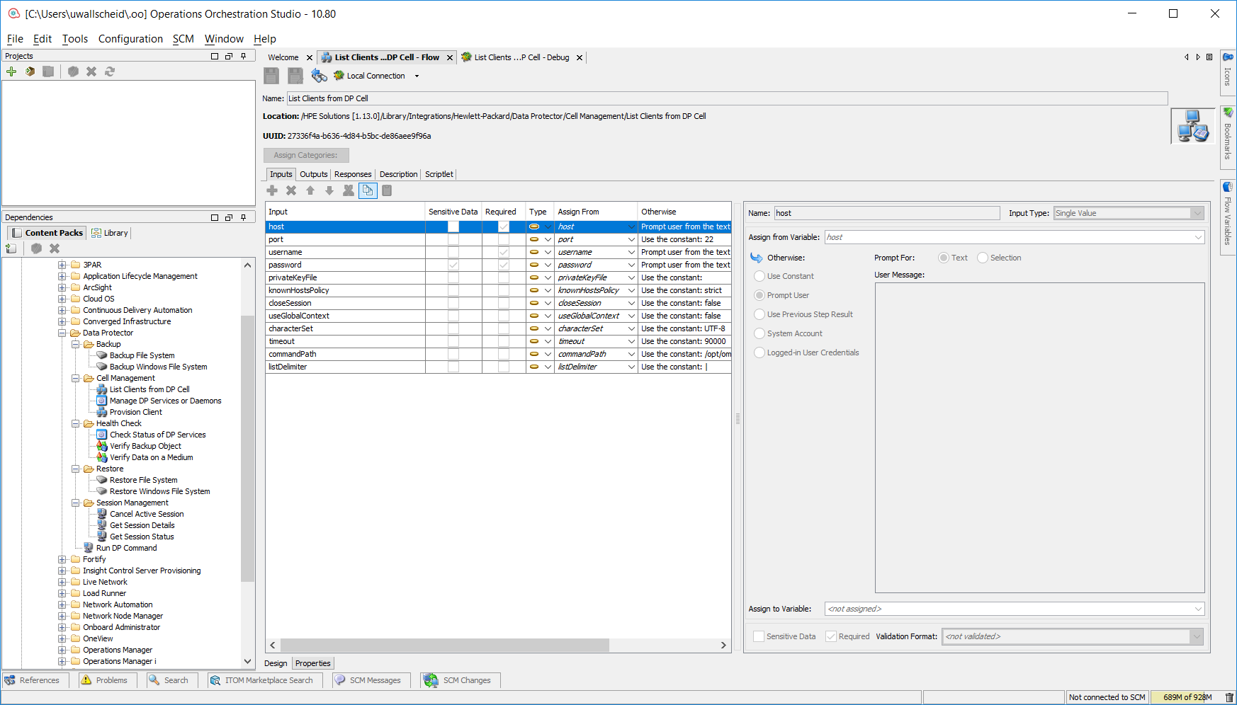
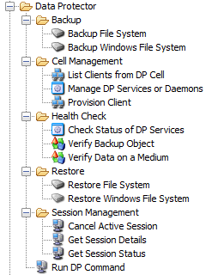
OO Content Pack for Data Protector
On top of the basic OO framework several "Content Packs" are installed adding workflows to be used. One of them is the "Micro Focus Content Pack" including basic Data Protector workflows.
Operations Orchestration is not bundled with Data Protector and has to be purchased seperately.
The Content Packs and incorporated workflows are for free and to considerd like starting points.
Further customization may need additional expertise at a cost.
All OO Content Packs can be downloaded from:
https://marketplace.microfocus.com/itom/category/all?product=Operations%20Orchestration&version=All%20versions&company=All%20companies
Search for "OO Micro Focus Solutions Content. You may filter for "Operations Orchestration" and Vendor "Micro Focus".
Notes:
OO is a workflow manager that lets you automate repetitive and compley tasks. It can be used to deploy Data Protector agents and integrations as well as taking care of prerequisites and system settings (like checking for
network name resolution). Some basic DP workflows exist and a availble for download on the Micro Focus Marketplace.

Slide 63
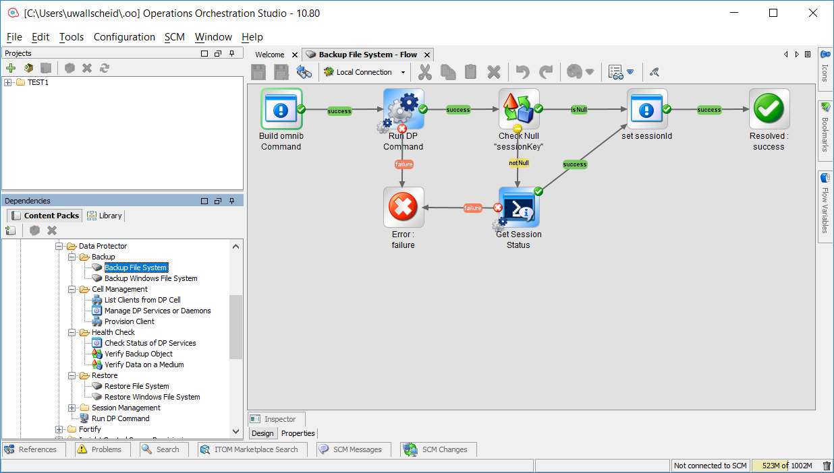
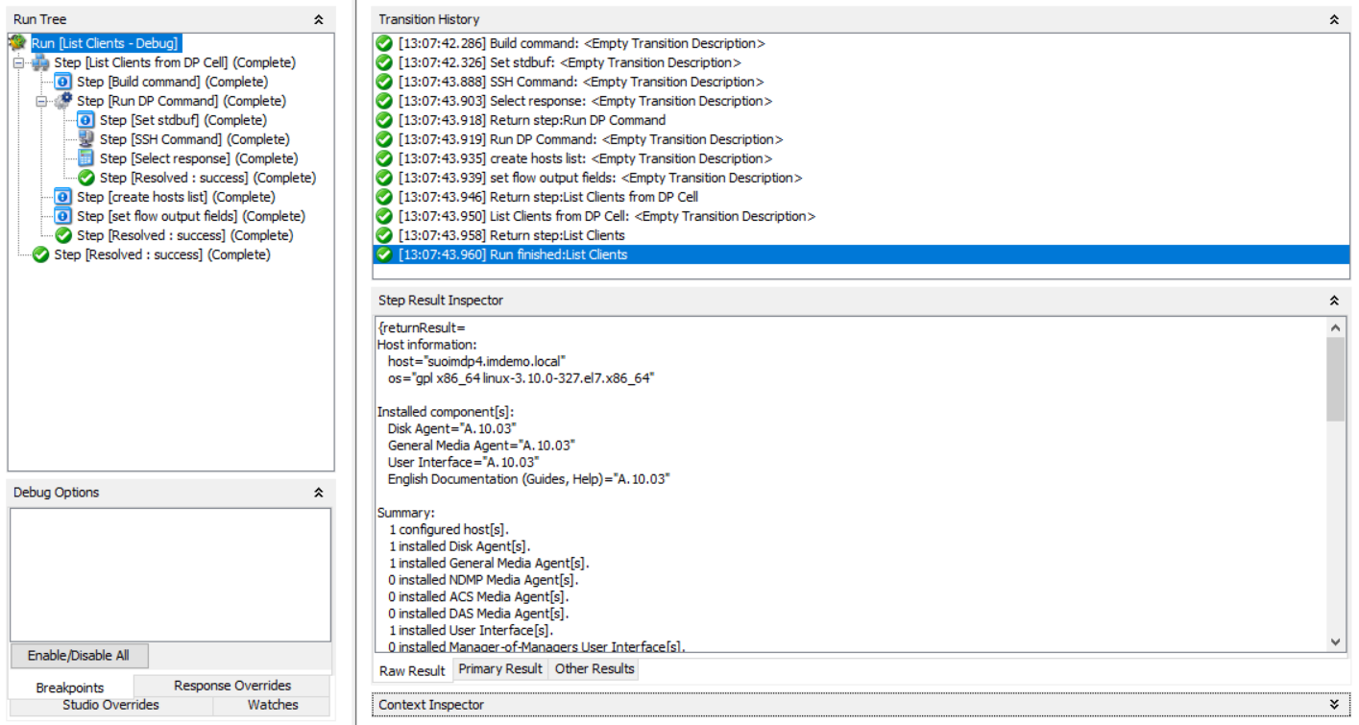
OO Workflows for Data Protector
Some default workflows are available today. Over time more sophisticated workflows will be provided.
From here flows can be customized for certain needs.
Notes:
These two slides are the overview of workflow design and also runtime output of a workflow. In this example is lists DP clients and components installed.

Slide 64
Use Cases

Slide 65

Backup Strategy Optimization
Scheduling Performance
Check SLAs Runtime
Re-Check Proove points
Apply Settings Tuning
Notes:
The backup circle of life ;-)
Start deploying the solution
Check how your deployment is doing
Optimize based in the analysis you're got
Check again to validate improvments

Slide 66
Analytics, Automation and Orchestration
Operations orchestration for automation of backup tasks
Step 1
Step 2
Step 3
Step 4
Step 5
Deploy DP agents to client
Configure the client agent
Create backup specs
Create schedules
Run first backup
Backup file system workflow example
Without orchestration
Set up each step manually
Check documentation for specifications
Apply patches
Wait for each step to complete
Resolve error messages
Engage the next step
Minutes per client
With orchestration
Build omnib Command
Run DP Command
CheckNull “sessionKey”
Set sessionid
Resolved success
Seconds per client
Error: failure
Get Session Status
Notes:
OO – annoucend with Data Protector 10.04
Our first Content Pack is available from ITOM Marketplace at https://marketplace.microfocus.com/itom/content/oo-micro-focus-solutions-content
Example of a backup process. Traditional approach without OO will take approximately 15min/server. An automated process with OO will take a few seconds.
Customer value: fewer manual tasks save time, improve productivity of the IT team and improve backup performance due to standardized workflows and less error-prone manual work.
Orchestration is simply the coordination of automated tasks and activities across teams, tools, and environments.
Orchestration strings together disparate processes and proceduralizes essentially any process.
Automation is the engine that allows the wheels of orchestration to turn.
In an orchestrated IT environment, the majority of steps are automated, and manual interventions are the exception.

Slide 67








Next Steps
Free Trial
Collateral
Customer Stories
Whitepapers
www.microfocus.com/dataprotection
Support Forum
Idea Exchange
Blogs
Product Documentation

